Slide 1
Data Exploration
THE MANTICORES
David Hauser
Erich Konicek
Martin Weber
Zabato Bebe

Slide 2
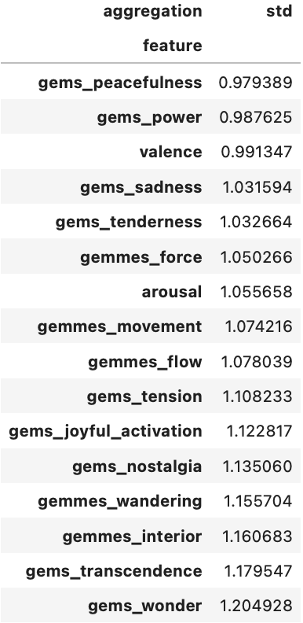
How consistent are the emotion annotations?
Do different annotators agree in their ratings of the same excerpt?
It depends!
low std → high consistency
Standard deviation is a good indicator for annotation consistency.
high std → low consistency
Conclusion: Some emotions are more objective than others.

Slide 3
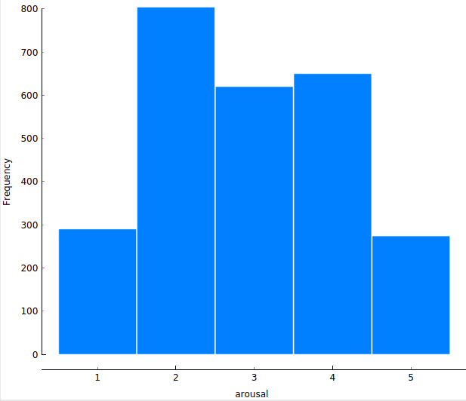
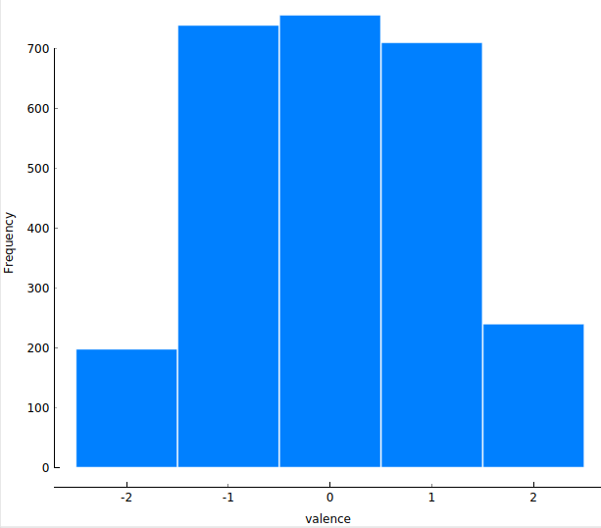
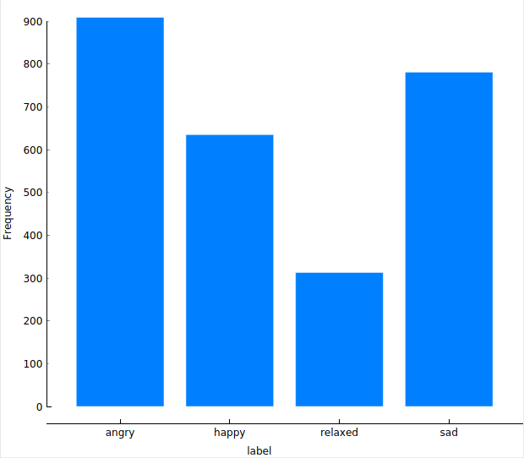
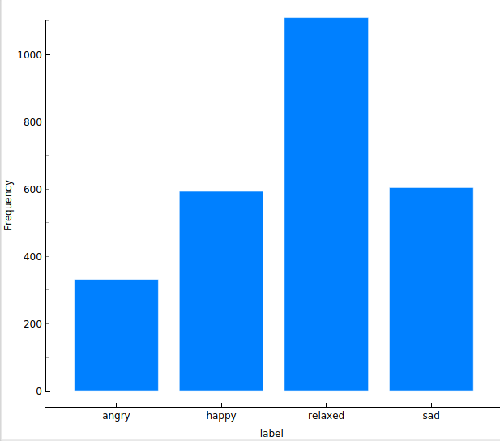
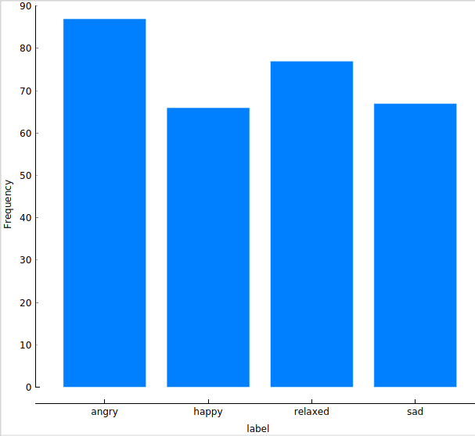
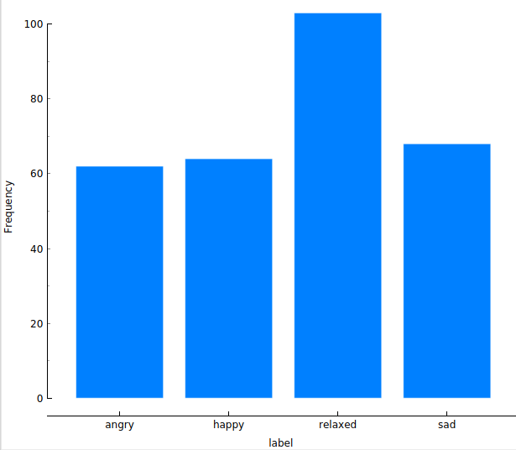
Derive Quadrant-Based Labels
Distribution of arousal & valence in raw annotation data
Looks a bit of Gaussian normal distribution.
So it is important how the middle values are classified.
Overall means: arousal: 2.93, valence: 0.02.
Decided on the following classification:
Slightly different classification results in a total different distribution:
Angry | arousal ≥ 3, valence ≤ 0
Happy | arousal ≥ 3, valence > 0
Sad | arousal < 3, valence ≤ 0
Relaxed | arousal < 3, valence > 0
Angry​ | arousal > 3, valence = 0​
Happy​ | Arousal > 3, valence ≥ 0​
Sad​ | arousal ≤ 3, valence = 0​
Relaxed​ | arousal ≤ 3, valence ≥ 0​
Many possibilities to label aggregated data over annotators(e.g. take median of arousal/valence or majority vote over raw labels) -> result very dependent on values 3 & 0 for arousal/valence
Mean of arousal/valence over all annotators seems to be the best fit to avoid clustering at 3 & 0. Values 3 & 0 were assigned s.t. distribution is as balanced as possible. Outliers are no problem in this case since annotations are in a fixed range.
With the mean-value not in the „=“:
Less balanced, if the mean-value is in the range with „=“:
Angry | arousal ≥ 3, valence ≤ 0
Happy | arousal ≥ 3, valence > 0
Sad | arousal < 3, valence ≤ 0
Relaxed | arousal < 3, valence > 0
Angry​ | arousal > 3, valence = 0​
Happy​ | Arousal > 3, valence ≥ 0​
Sad​ | arousal ≤ 3, valence = 0​
Relaxed​ | arousal ≤ 3, valence ≥ 0​

Slide 4
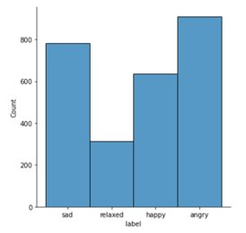
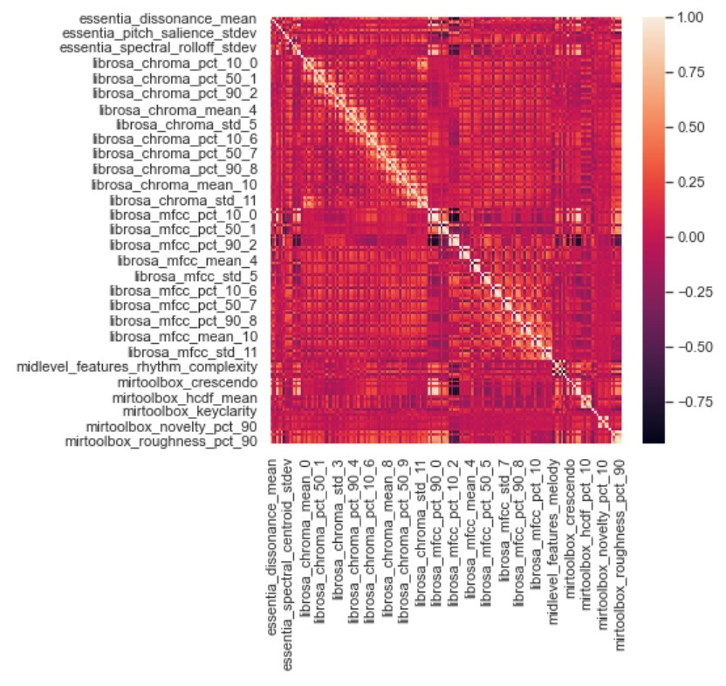
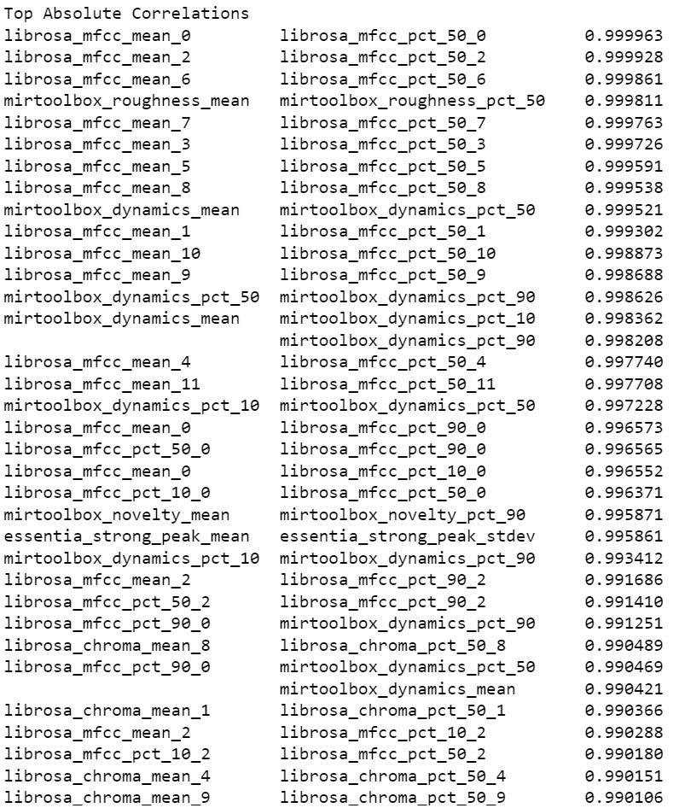

Class & Feature Distribution
Correlation Matrix using Pearson
Most frequent class label -> angry
Least frequent class label -> relaxed
By defining the measure of balance as follows
Entropy divided by log(k), where k is the number of classes and c_i is the number of samples per class
Results in a range between 0 and 1
We get a balance of 0.954 which implies that the class labels are fairly balanced
Overall not many feature pairs have a correlation, but some do have a very strong relation with:
36 pairs having a correlation coefficient of >0.99 and 237 pairs of >0.9

Slide 5
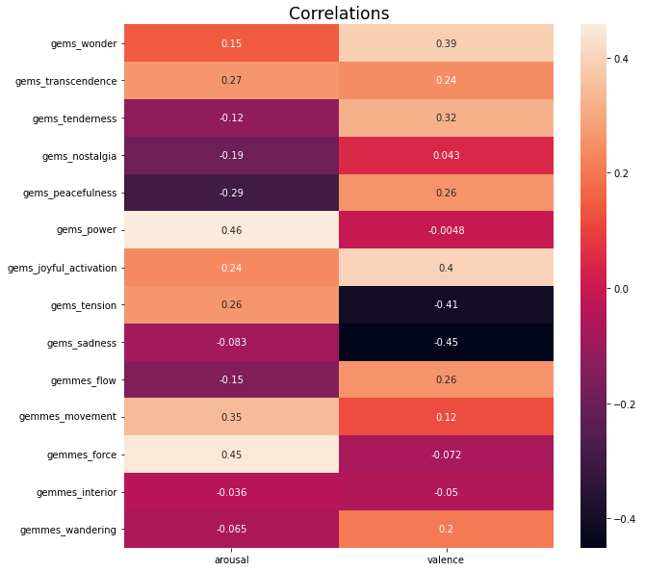
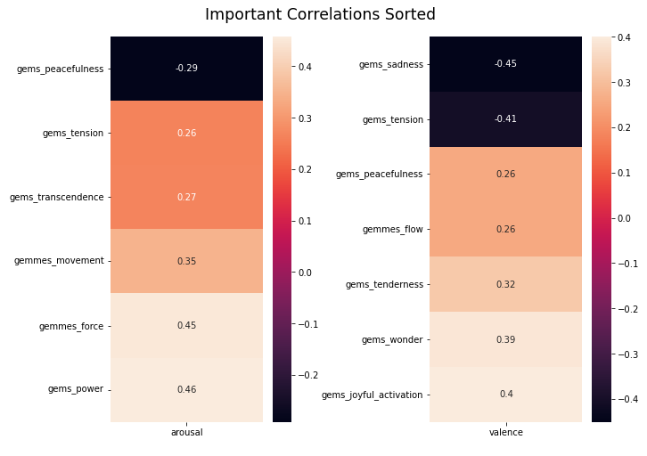
GEMS9 and GEMMES relations to arousal and valence
Used spearman method to calculate correlations coefficients since we are dealing with ordinal data
Some correlations appear between GEMS9/GEMMES and arousal/valence but no strong relationships
Different features have a more meaningful impact on arousal and valence
GEMMES features tend to have a stronger positive/negative correlation than GEMS9

Slide 6
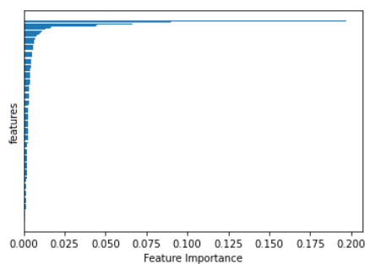
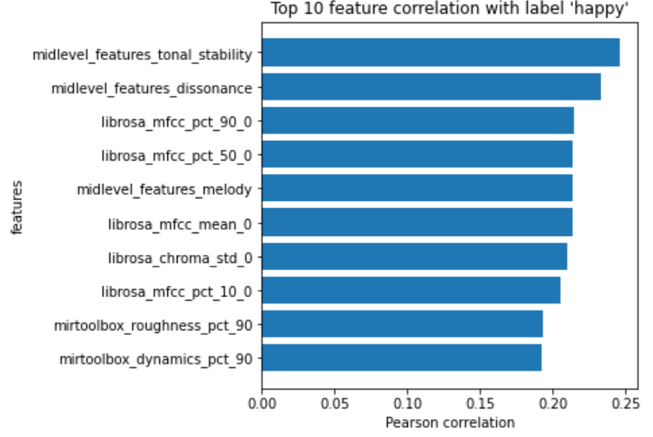
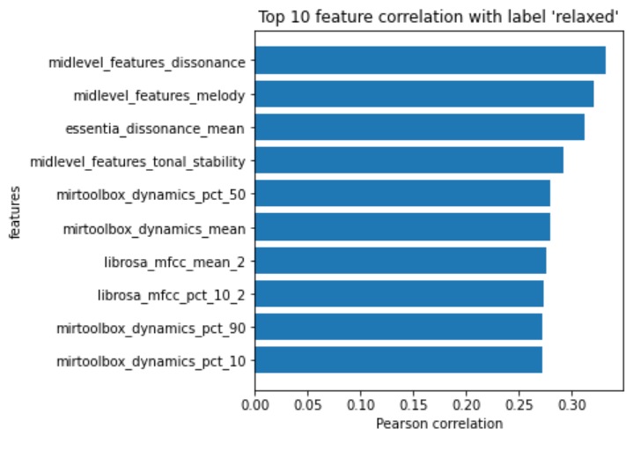
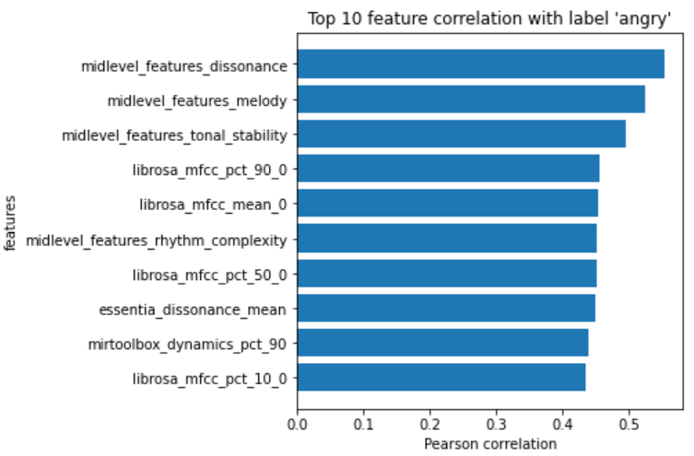
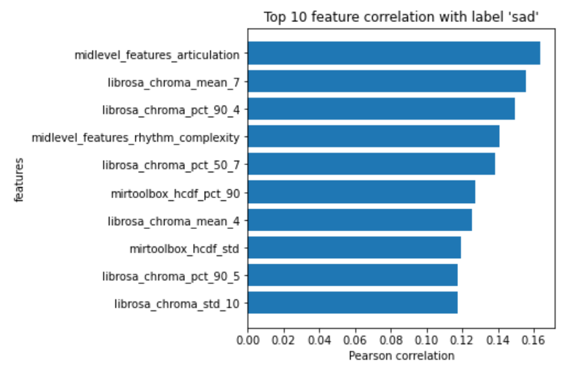
Feature Importance
Pearson Correlation between Features & Labels
By calculating Gini importance with a random forest only a handful of features seem to be relevant: In particular the most important feature is midlevel_features_dissonance
Large overlap of most important features between Gini Importance and Pearson correlation

Slide 7
Conclusion
After exploring the data we got some useful insight on our dataset.
By taking the standard deviation we saw that the annotations do not differ that much with a mean of 1.084 and a range of 0.979-1.205.
We also got a good feeling on how the middle values of arousal and valence affect the class labels, that's why we first aggregated the raw data and derived the labels from the mean of arousal/valence. After that we saw the resulting classes are rather balanced and that the features are slightly positive skewed. With no strong correlations between GEMS9/GEMMES and arousal/valence, every high-level feature seems to be as equally important.
Going through all these tasks we conclude that we can ignore many low-level features for the next project phase and that we should consider the general rating preference of individual annotators.

